Slide 1
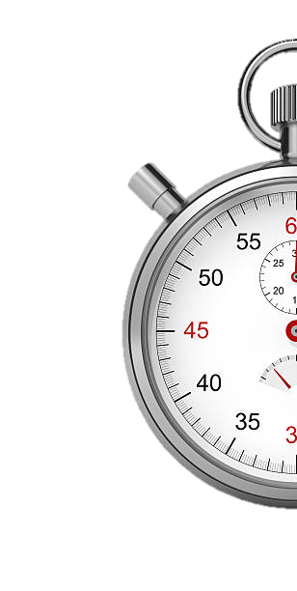
DIGITAL LOGIC DESIGN PROJECT
Air University Kamra
PRESENTING
DIGITAL STOPWATCH
Group 03
Faiqa Umar
Anisa Khan
Aima
Group 04
Wasif Ali
Saad Ali
M. Huzaifa
DEPARTMENT OF COMPUTER SCIENCE | AIR UNIVERSITY – KAMRA CAMPUS

Slide 2

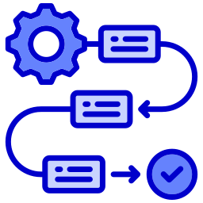




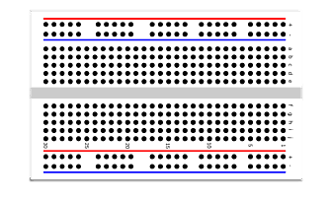




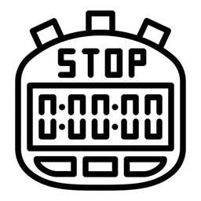


OUTLINE
Introduction
Methodology
Simulations
Hardware Implementation
Cost Analysis
Applications
Conclusion
1/10

Slide 3
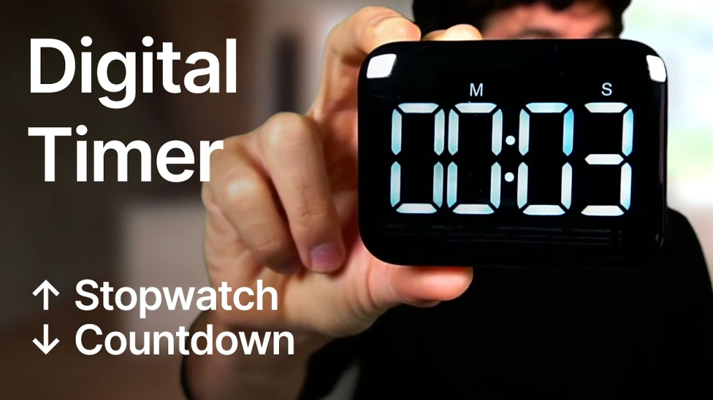
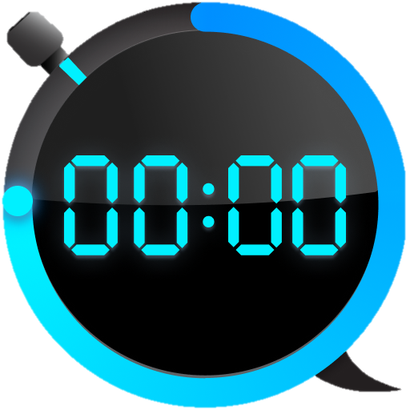
INTRODUCTION
A Digital Stopwatch that counts from 00:00 to 59:59
Purely hardware-based: No microcontroller or software
Demonstrates real-time timekeeping using logic ICs
Educational focus on pulse generation, counting, and display
Enhances understanding of digital logic and display systems
2/10

Slide 4
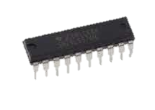
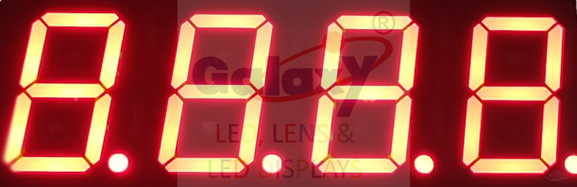
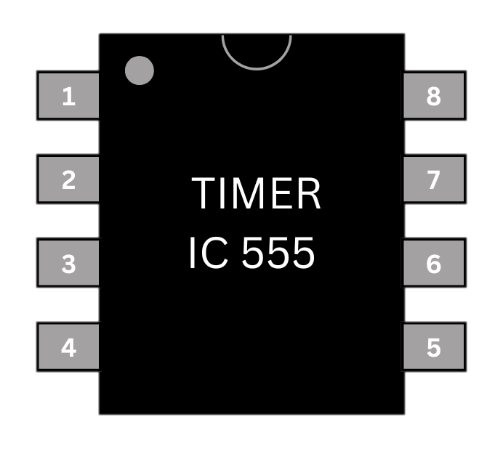
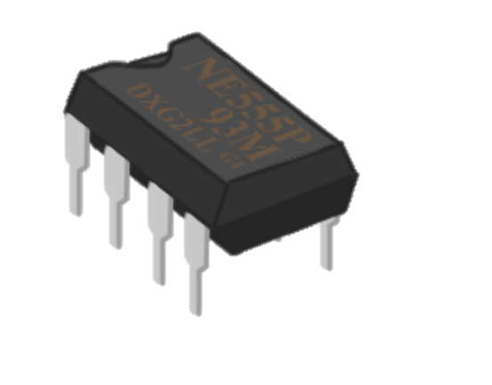
METHODOLOGY (Overview)
1Hz clock pulse generation using 555 Timer (Astable Mode)
Toggle Flip-Flop for Start/Stop Control
AND Gate logic to pass/pause clock pulses
4 CD4026 counters for MM:SS counting
7-segment displays for visual output
Push-button for reset function
GROUNG
TRIGGER
OUTPUT
RESET
+Vcc
DISCHARGE
THRESHOLD
CONTROL VOLTAGE
3/10

Slide 5
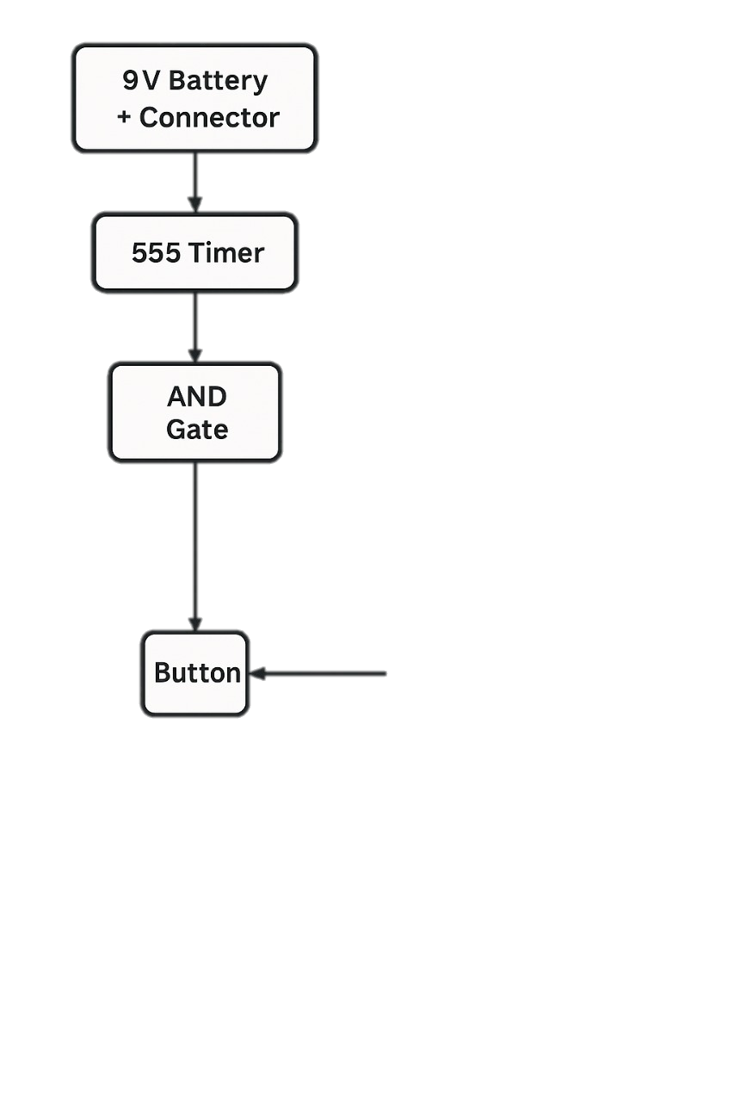
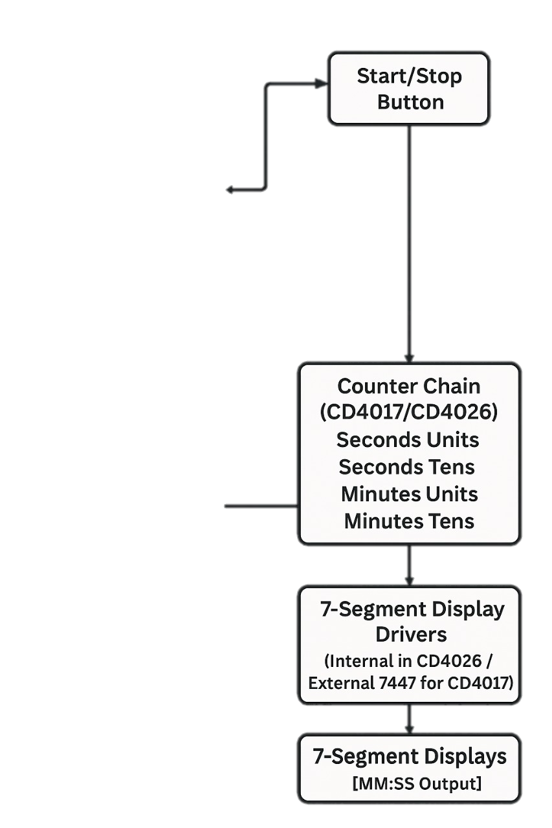
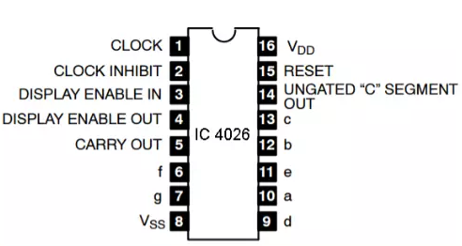
METHODOLOGY (Block Diagram)
Power Supply → Clock Generator (555 Timer)
Start/Stop Control → Counter Chain (CD4026)
7-Segment Displays
Reset Logic
4/10

Slide 6
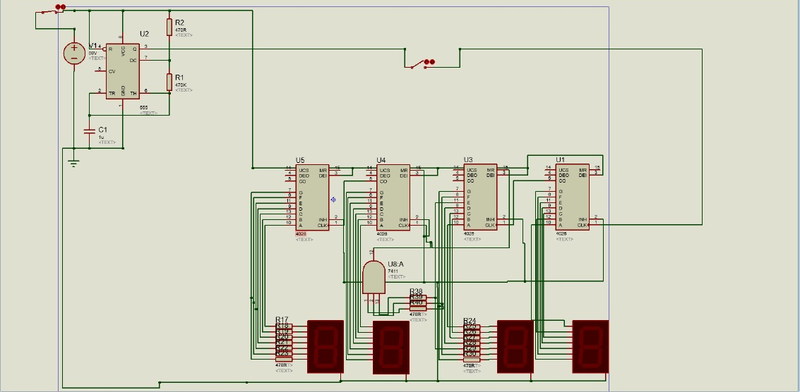
SIMULATION RESULTS
5/10

Slide 7
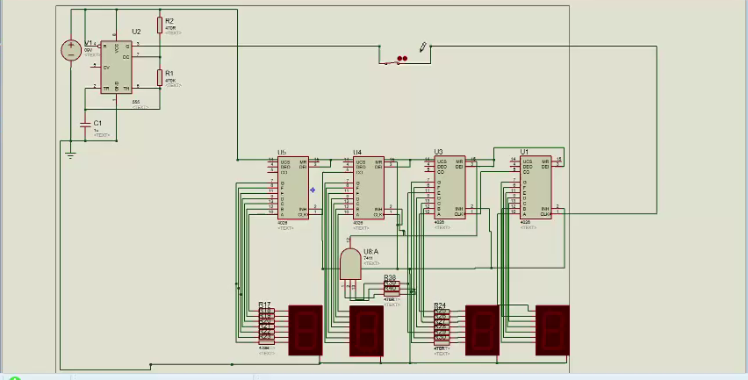
SIMULATION WORKING
6/10

Slide 8
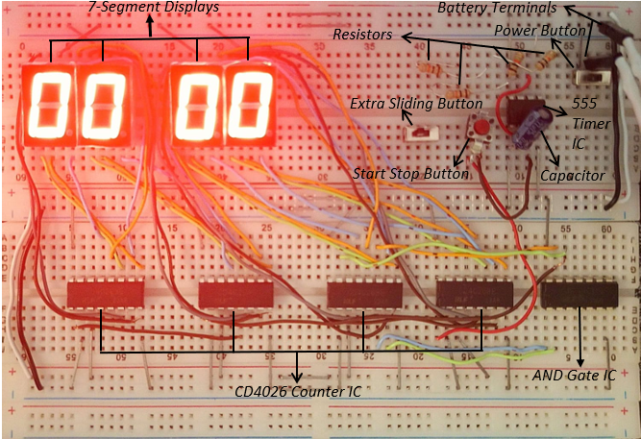
FINAL HARDWARE RESULT
7/10

Slide 9
COST ANALYSIS
Component | Quantity | Unit Cost (PKR) | Total (PKR)
CD4026 IC | 4 | 100 | 400
555 Timer IC | 1 | 40 | 40
9V Battery | 1 | 270 | 270
Battery Clip | 1 | 40 | 40
220Ω Resistors | 40 | 5 | 200
Capacitors (470µF & 47pF) | 1 each | 20 & 10 | 30
Breadboards | 3 | 270 | 810
Push Buttons | 2 | 30 | 60
Jumper Wires | — | — | 350
Total | — | — | 2,200 PKR
8/10

Slide 10

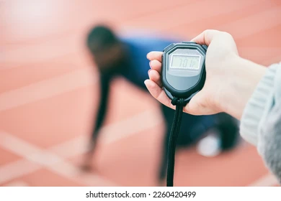
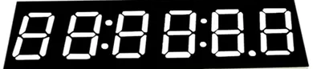
APPLICATIONS
Lab experiments for measuring precise durations
Can be applied in sports timing (e.g., races, drills)
Base for real-time clocks or countdown systems
Educational tool to teach digital logic
Can be extended with microcontrollers or IoT integration
Can be extended to track hours by adding more counters
Acts as a base for countdown timers or real-time clocks
9/10

Slide 11

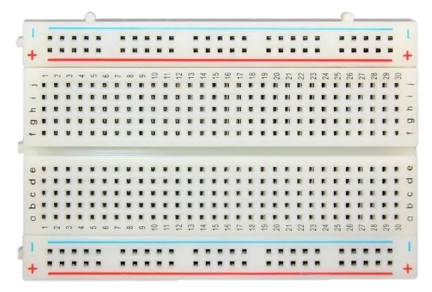
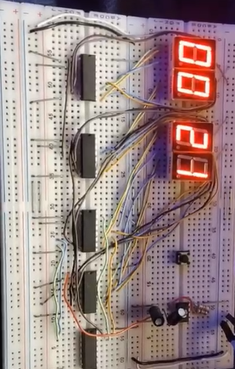





CONCLUSION
BEFORE
Designed a working digital stopwatch using logic gates and ICs
Reinforced understanding of timing, sequencing, and digital display
Hardware and simulation stages teach real-world circuit behavior
Ready for further enhancement in future projects
AFTER
10/10

Slide 12
THANK YOU

